Slide 1



ANTI MONEY LAUNDERING SYSTEM IN CRYPTOCURRENCY USIGN AI&ML
BATCH NO:14
PRESENTED BY:
NAME: S.STANLY REG NO:510421104098
NAME: S.SUBRAMANI REG NO:510421104100
NAME: S.SUDHARSHAN REG NO:510421104102
NAME: V.VIJAYAKUMAR REG NO:510421104116
GUIDED BY :
Mr.K.NEELAMEGAM M.Sc., M.Tech.,
DEPARTMENT OF CSE 14/05/2025

Slide 2
AGENDA
CS3811-PROJECT WORK
Abstract
Introduction
Problem Statement
Literature Survey
Extract of Literature Survey
Existing System
Proposed System
Methodology
Tools and Technologies
System Architecture
Module Description
Implementation
Challenges and Limitations
Future scope
References
Conclusion
DEPARTMENT OF CSE 14/05/2025

Slide 3
CS3811-PROJECT WORK
ABSTRACT
Money laundering poses a significant threat to global financial systems, enabling criminals to disguise illicitly obtained funds as legitimate income. Its detection remains an ongoing challenge for law enforcement agencies, especially as financial transactions increasingly shift toward complex digital ecosystems, including cryptocurrency. Traditional methods of detecting money laundering, such as rulebased systems and manual audits, are proving to be inadequate in the face of sophisticated laundering techniques and the sheer volume of transactions. This project proposes the development of an AI and machine learning-based Anti-Money Laundering (AML) system designed to meet these modern challenges. The system integrates advanced cryptographic techniques to ensure data privacy and integrity while enhancing the accuracy and efficiency of detecting illicit financial transactions. Machine learning algorithms—such as anomaly detection, clustering, and classification—are employed to analyze large-scale transaction data, identify hidden patterns, and predict anomalies that may indicate money laundering activities. The system also incorporates real-time monitoring capabilities to flag suspicious activities promptly, enabling quicker response and intervention. By combining the strengths of artificial intelligence, machine learning, and cryptography, the proposed AML system significantly improves detection and prevention mechanisms. This hybrid approach not only enhances regulatory compliance but also provides a scalable and adaptive framework that can evolve alongside emerging financial technologies. The project aims to contribute to the global fight against financial crime by offering a robust, intelligent solution capable of mitigating risks and safeguarding the integrity of financial systems.
DEPARTMENT OF CSE 14/05/2025

Slide 4
CS3811-PROJECT WORK
INTRODUCTION
Cryptocurrencies: decentralized, fast, and pseudonymous
Criminals exploit crypto to hide illegal money flows.
Traditional AML tools can't track decentralized networks.
AI/ML offer automation, learning, and anomaly detection.
Cryptography ensures secure handling of financial data.
Growing need for tech-driven AML tools in blockchain systems.
Government and financial bodies push for improved crypto regulation.
DEPARTMENT OF CSE 14/05/2025

Slide 5
CS3811-PROJECT WORK
PROBLEM STATEMENT
Traditional AML systems are rule-based and static.
Crypto transactions are anonymous and decentralized.
Manual systems cannot scale with transaction volume.
Real-time laundering detection is currently ineffective.
Complex methods like smurfing and chain-hopping go undetected.
Lack of blockchain integration in legacy AML tools.
Global nature of crypto complicates jurisdiction and compliance.
DEPARTMENT OF CSE 14/05/2025

Slide 6
LITERATURE SURVEY
Shazia Nawaz: Used clustering and regression for AML.
Shih et al.: ML models outperform rule-based AML.
Zhang et al.: Blockchain and cryptography for AML.
Liao et al.: Neural networks for predicting illicit flows.
FATF guidelines recommend advanced tech in AML.
AML solutions with hybrid models showed better accuracy.
Real-time systems emphasized for actionable AML response.
DEPARTMENT OF CSE 14/05/2025

Slide 7
EXTRACT OF LITERATURE SURVEY
Common ML methods: Random Forest, KNN, XGBoost.
Blockchain enables transparent yet pseudonymous tracking.
XGBoost showed high accuracy for crypto transaction fraud.
Graph-based tools help visualize laundering networks.
Hybrid models outperform single algorithm systems.
Labeled data improves accuracy, but availability is low.
Time-sequencing helps detect repeated laundering behaviors.
DEPARTMENT OF CSE 14/05/2025

Slide 8
CS3811-PROJECT WORK
EXISTING SYSTEM
Based on static rules like fixed thresholds.
Cannot detect evolving laundering techniques.
High false positive rate leads to alert fatigue.
Requires human intervention to verify anomalies.
Designed for centralized fiat systems, not blockchain.
Limited visualization or pattern tracking capabilities.
No learning or adaptability for new laundering trends.
DEPARTMENT OF CSE 14/05/2025

Slide 9
CS3811-PROJECT WORK
PROPOSED SYSTEM
Employs AI/ML for pattern recognition in real-time.
Uses anomaly detection to flag suspicious activity.
Cryptographic hashing ensures transaction data integrity.
Visual mapping of smurfing and circular laundering paths.
System adapts and learns from new transaction trends.
Blockchain-compatible and scalable to large datasets.
Alert system integrated with dashboard for insights.
DEPARTMENT OF CSE 14/05/2025

Slide 10
CS3811-PROJECT WORK
METHODOLOGY
Data Collection – Crypto exchange & blockchain data.
Preprocessing – Remove duplicates, normalize data.
Feature Extraction – Analyze transaction behavior.
Model Training – ML models trained on labeled data.
Anomaly Detection – Unusual behaviours are flagged
Alert & Visualize – Real-time dashboard + alerts.
Cryptographic Check – Integrity maintained via hashing.
DEPARTMENT OF CSE 14/05/2025

Slide 11
CS3811-PROJECT WORK
TOOLS AND TECHNOLOGIES
Language: Python 3.10
ML Libraries: Scikit-learn, TensorFlow, XGBoost
Graph & Visualization: NetworkX, Matplotlib
Cryptography: RSA, SHA-256 hashing
Framework: Flask for backend integration
IDE: PyCharm
Data Platform: CSV + blockchain explorer APIs
DEPARTMENT OF CSE 14/05/2025

Slide 12
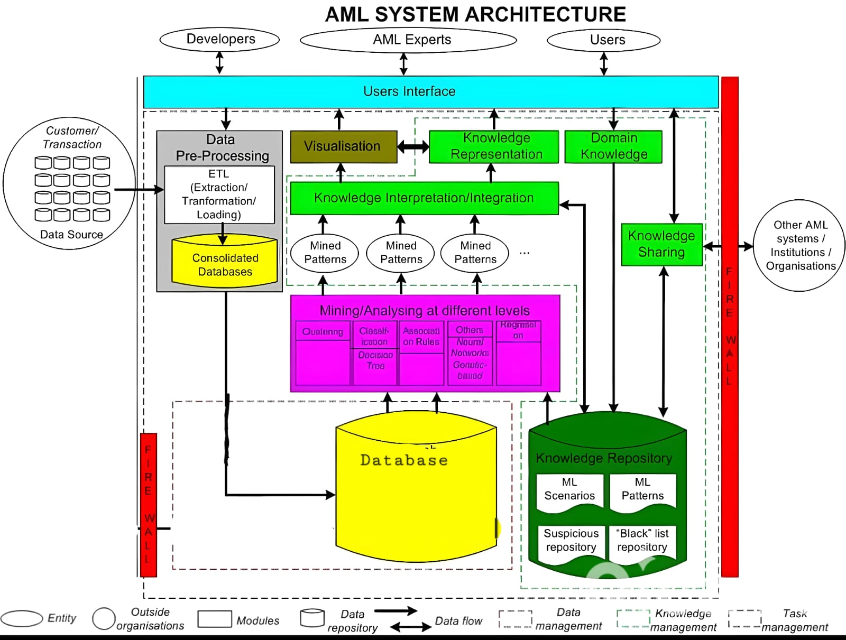
CS3811-PROJECT WORK
SYSTEM ARCHITECTURE
DEPARTMENT OF CSE 14/05/2025

Slide 13
CS3811-PROJECT WORK
MODULE DESCRIPTION
1. Data Collection
Source: Data is collected using public APIs and sample datasets from well-known blockchain explorers like Etherscan, Blockchain.com, or Blockchair.
Scope: Includes transactional data (sender, receiver, value, gas fee, timestamp), wallet metadata, and block-level information.
2. Preprocessing
Null Handling: Removes or imputes missing values in transaction fields.
Standardization: Converts all timestamps to a uniform format (e.g., UTC), and ensures consistency in cryptocurrency units (e.g., Wei to ETH).
Outlier Filtering: Initial filtering of known testnet addresses and synthetic data.
Noise Reduction: Elimination of low-impact micro-transactions not relevant to laundering patterns.
3. Feature Extraction
Behavioral Metrics:
  Transaction Frequency: Number of transactions per wallet over time.
  Volume Patterns: Total and average transaction volume.
DEPARTMENT OF CSE 14/05/2025

Slide 14
CS8811-PROJECT WORK
4. Model Training
Algorithm Used: Trains on labeled or semi-supervised data using algorithms like Random Forest, XGBoost, or Isolation Forest.
Labeling: Uses known fraudulent addresses from datasets.
5. Anomaly Detection
Live Stream Monitoring: Continuously ingests data and flags real-time anomalies.
Indicators:
  Sudden large transfers
  Rapid circular transactions
  Fund dispersion into many smaller wallets (a sign of smurfing)
Scoring Engine: Assigns a risk score to each transaction or wallet based on deviation from normal behavior.
6. Reporting Module
Dashboard: Visual summaries of detected fraud, transaction volumes, and high-risk wallets.
DEPARTMENT OF CSE 14/05/2025

Slide 15
CS3811-PROJECT WORK
IMPLEMENTATION
Used labeled crypto transaction dataset (Bitcoin/Ethereum).
ML models: Random Forest, Decision Trees.
Graphs to detect smurfing and layering paths.
Model accuracy tested using confusion matrix & ROC.
Alerting system flags suspicious addresses in real-time.
Integrated cryptographic hash for integrity check.
Flask used for UI and dashboard display.
DEPARTMENT OF CSE 14/05/2025

Slide 16
CS3811-PROJECT WORK
FUTURE SCOPE
Add support for privacy-focused coins with enhanced tracking.
Expand to include smart contract for AML auditing.
Integrate exchange APIs for live monitoring.
Use deep learning for behavioral pattern prediction.
Offer system as cloud-based SaaS for financial firms.
Explore federated learning for data privacy.
Collaborate with regulators for real-world deployment.
DEPARTMENT OF CSE 14/05/2025

Slide 17
CS3811-PROJECT WORK
REFERENCES
S. Nawaz and H. Ghous, "Detection of Money Laundering Using Data Mining Models: A Review," International Journal of Computer Applications, vol. 180, no. 18, pp. 1–6, Feb. 2018.
H. Shih, Y. Hsu, and W. Wu, "A Machine Learning Approach for Anti-Money Laundering Detection," in Proc. IEEE Int. Conf. Big Data (Big Data), 2019, pp. 5303–5305.
Y. Zhang, Z. Jiang, and M. Wang, "Cryptocurrency and Anti-Money Laundering: Challenges and Solutions," IEEE Access, vol. 8, pp. 169746–169755, 2020.
H. Liao, K. Wu, and S. Yang, "AI-Powered Money Laundering Detection in Financial Transactions," IEEE Transactions on Computational Social Systems, vol. 8, no. 2, pp. 345–356, Apr. 2021.
DEPARTMENT OF CSE 14/05/2025

Slide 18
CS3811-PROJECT WORK
CONCLUSION
The system bridges the gap between traditional AML methods and modern crypto-financial complexities.
Demonstrates potential of AI & ML in financial fraud detection.
Offers a scalable, real-time, and secure approach.
Contributes towards global efforts in safeguarding financial ecosystems from illicit activities.
DEPARTMENT OF CSE 14/05/2025

Slide 19
CS3811-PROJECT WORK
THANK YOU
DEPARTMENT OF CSE 14/05/2025

